Slide 1
Forwarding documents via DocuSign

Slide 2
Login to DocuSign
Select New, then select Send an Envelope
Upload Documents to be signed & Viewed recipient(s)
select individual docs OR
select all docs by depressing shift and clicking
each file from the browser
Enter the name of the recipient (will be stored for later use)
Enter the e-mail address (will be stored for later use)

Slide 3
Forwarding Instructions for PTD Staff
In the Add Recipient section, check the box for Set Signing Order.
1st on the line with the first recipient, click the drop-down arrow next to Needs to Sign and choose Update Recipients. 2nd enter the 1st recipient’s information

Slide 4
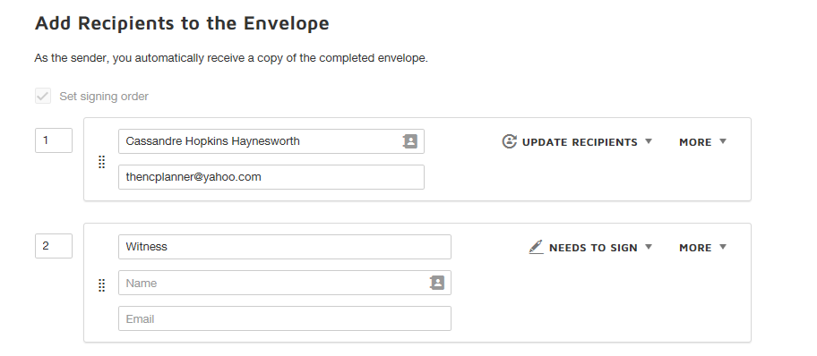
Click Add Recipient and enter the recipient's role/title (Witness). The name and email fields are going to remain blank for now.
After the 1st person signs, then that person will be responsible for entering the name and e-mail address when they forward the document(s) to be witnessed.

Slide 5
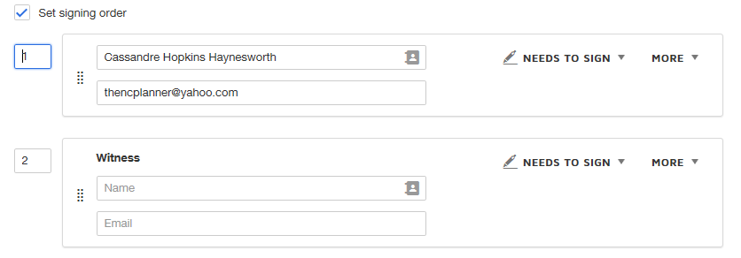
IMPORTANT: Go back and change the 1st signer’s action to Needs to Sign in order to allow 2 different (colored) signature placeholders to be in the document.

Slide 6
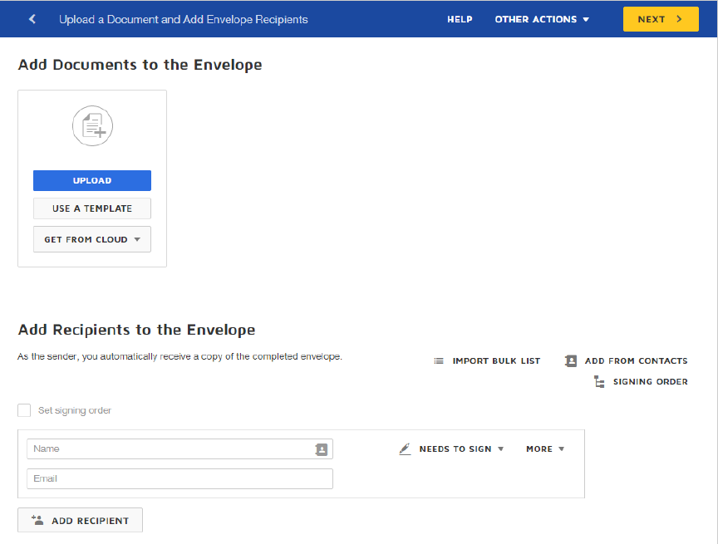

Slide 7
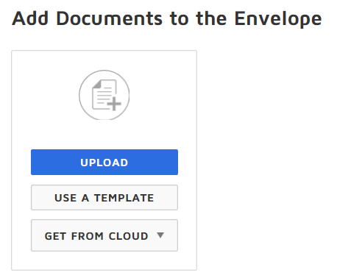

Slide 8
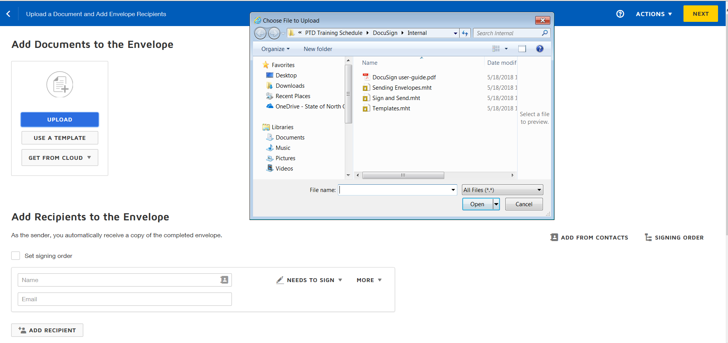

Slide 9
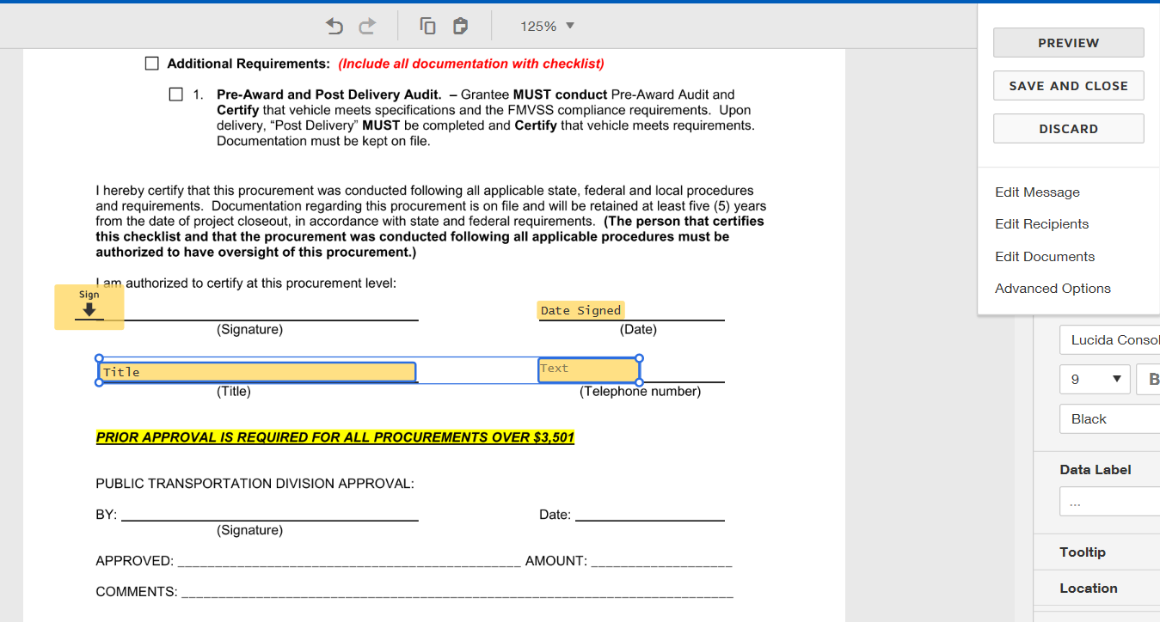
Actions…options for later…

Slide 10
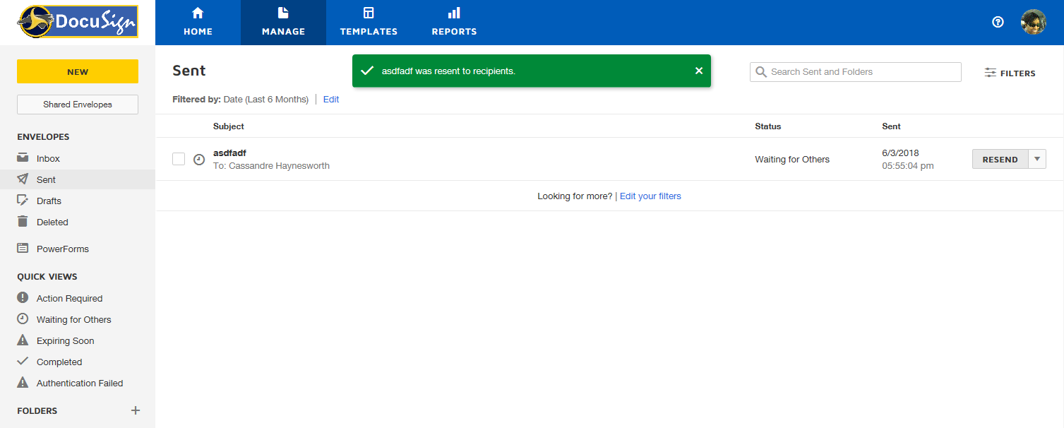
Successfully Sent Document(s)
Fast forward through the steps of sending…

Slide 11
Grantee/Subrecipient Steps to Forward signed docs to be Witnessed

Slide 12
Grantee receives notification via e-mail and clicks Review Document
The white checkbox must be checked by the grantee to proceed & enable the Continue button.

Slide 13
The 1st recipient will be required to enter the Witness’ e-mail address & name before proceeding.
After entering the contact information, select Complete and Send

Slide 14
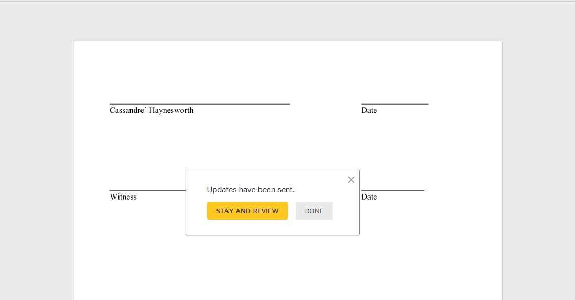

Slide 15
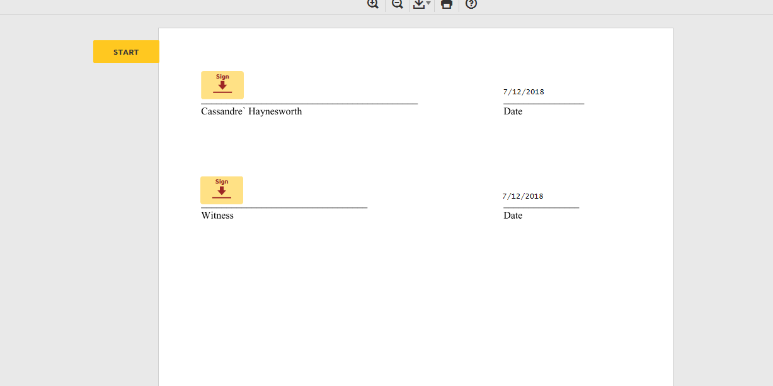
Prep for signing

Slide 16
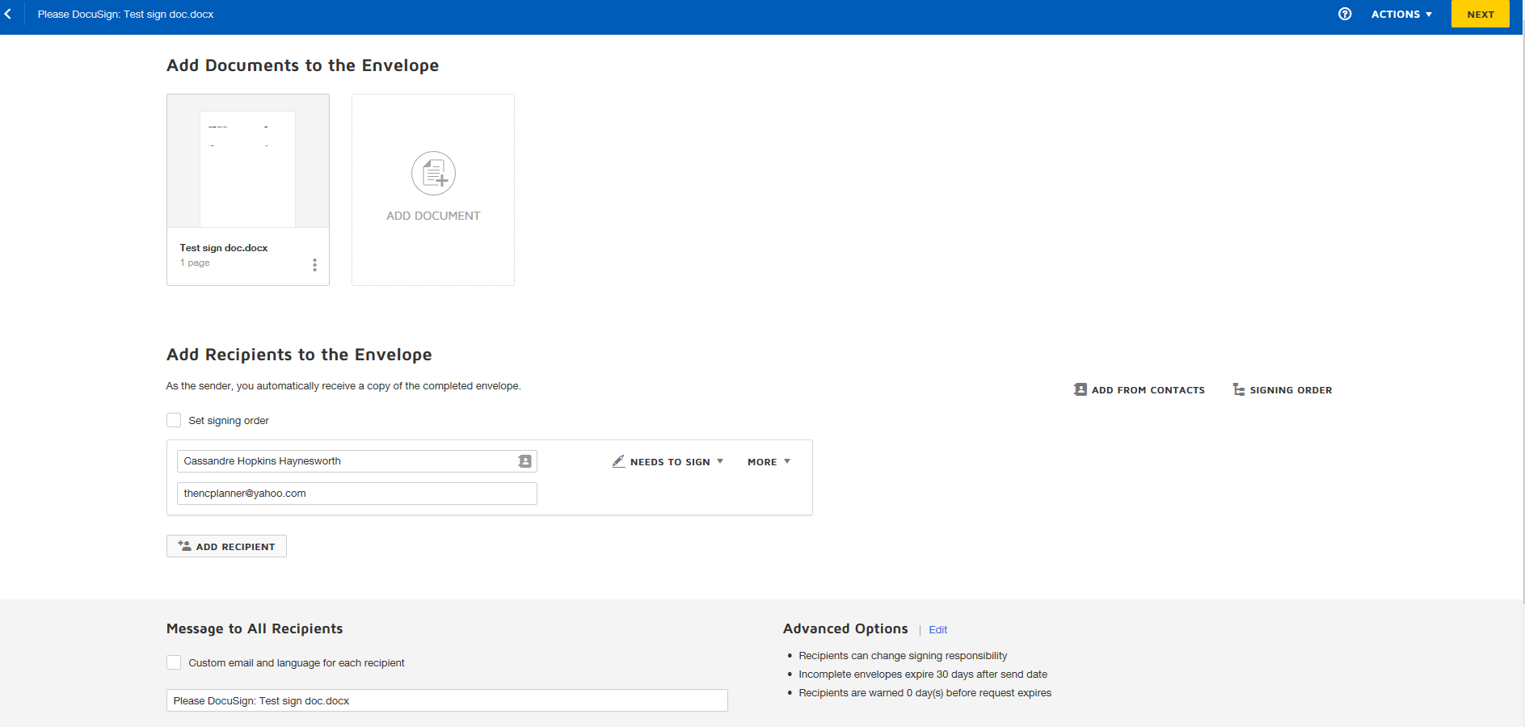
Prep for signing
Finance Staffers only enter one recipient in the add recipient section.
The recipient will have the option to add the recipient’s name and e-mail address after the 1st signatory has signed.
In the Message Box, instruct the recipient to forward the document to the 2nd signatory, who will witness it.

Slide 17
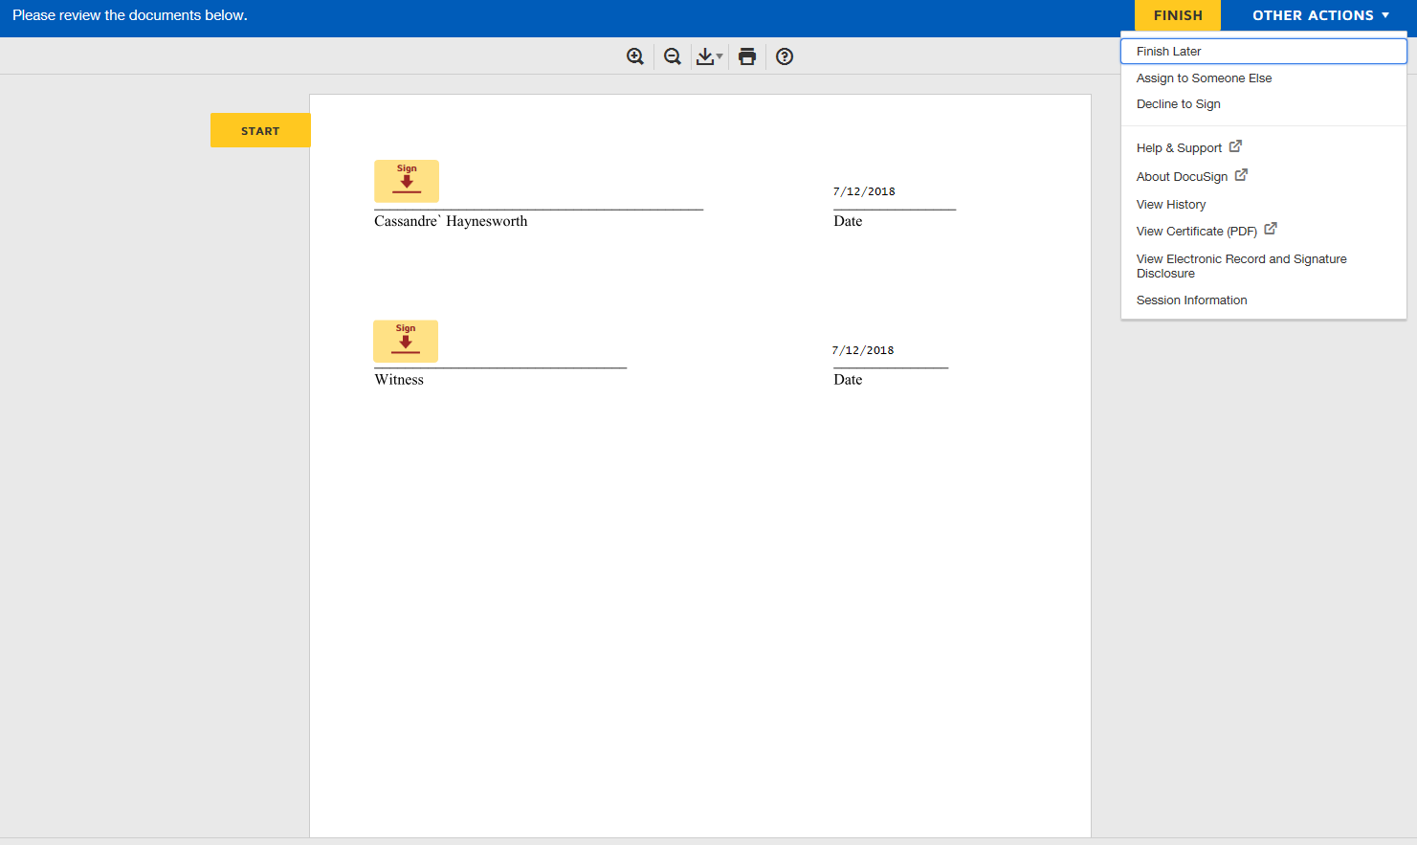

Slide 18
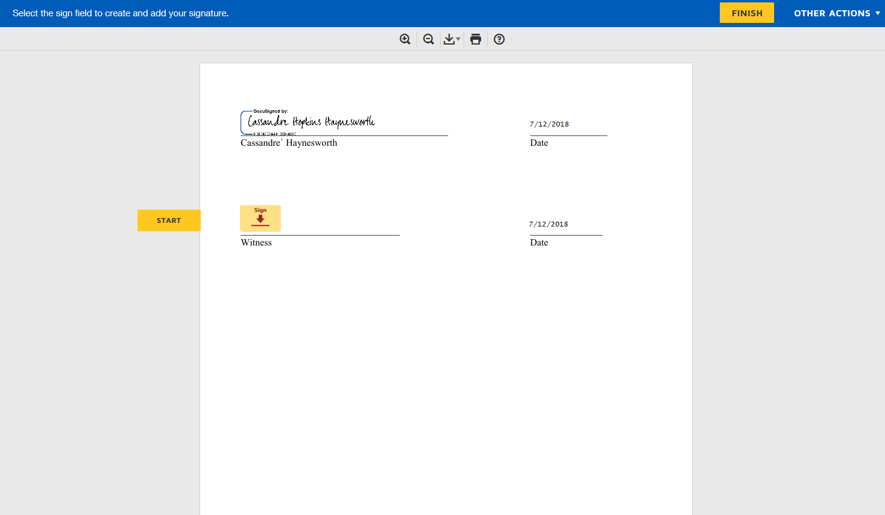

Slide 19
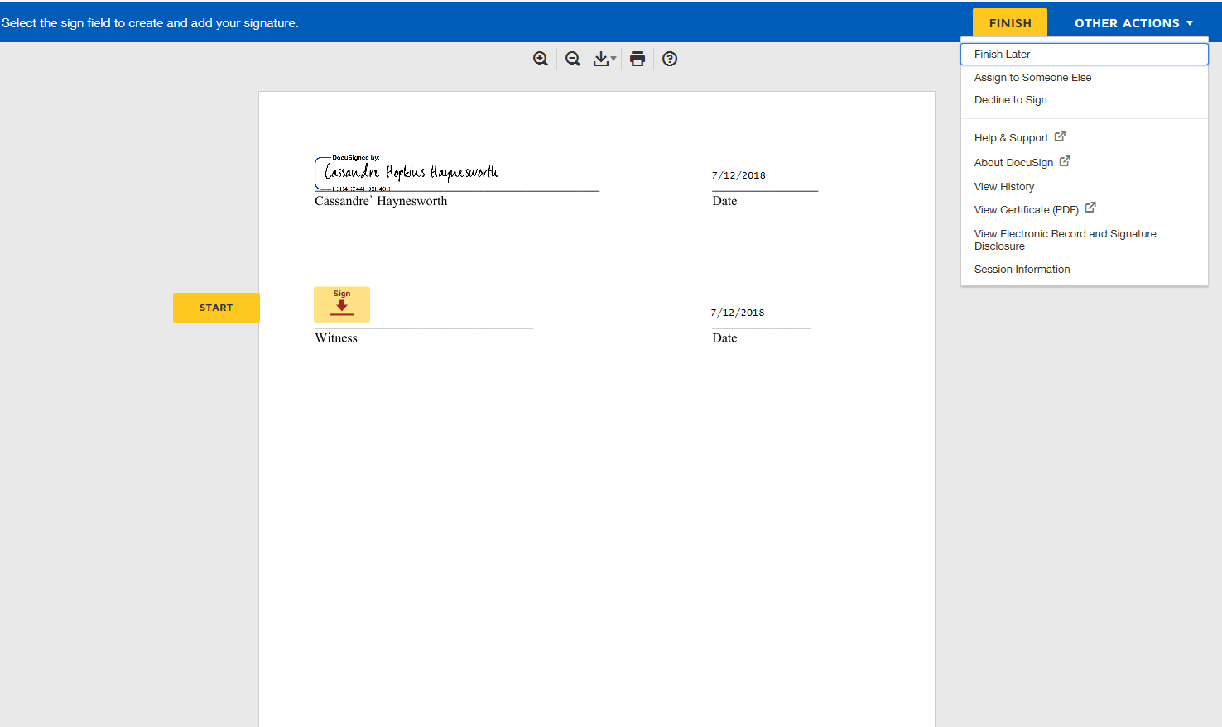

Slide 20
